Slide 1

LUNG NODULE DETECTION USING MULTI-MODAL DEEP LEARNING AND INTELLIGENT FEATUREOPTIMIZATION TECHNIQUES
.
CHALEENDRA UPENDAR RAO
(25CSE3001)
Semester –II
(AY 2025-26)
Supervisor:DR.KESHAVAMURTHY B.N.
Associate Professor
Department of Computer Science and Engineering
National Institute of Technology Goa
July, 2026

Slide 2
contents
.
Introduction
Related Work
Research Gaps
Problem Statement
Research Objectives
Proposed Methodology
Datasets
Future Direction
Course Work
References

Slide 3
introduction
.
Lung cancer is one of the leading causes of cancer-related deaths globally.
Early detection of lung nodules in CT scans significantly improves patient survival.
Manual analysis of CT images is time-consuming, subjective, and prone to error.
Deep learning models can automatically detect nodules with high accuracy, but most rely on CT images alone.
Fusing CT imaging with radiomic features and clinical metadata can capture complementary diagnostic information.
Hybrid architectures combining CNNs, attention mechanisms, and transformers improve detection of small and irregular nodules.
This research aims to build a robust, multi-modal, feature-optimized deep learning system for lung nodule detection.

Slide 4
related work (1/5)
# | Paper (Title, Author, Year) | Venue (CORE Rank) | Method | Advantage | Limitation
1 | Clinical Prior Guided Cross-Modal Hierarchical Fusion for Lung Cancer Diagnosis (CM-DAC) MICCAI Society, 2025 | MICCAI CORE: A | Hierarchical cross-modal fusion network guided by clinical priors, with a redundancy-suppression (YSD) module | Explicitly targets redundant-feature suppression while fusing clinical priors with imaging | Very recent; limited independent external validation so far
2 | Survival Prediction in Lung Cancer through Multi-Modal Representation Learning WACV 2025 authors, 2025 | IEEE WACV CORE: A | Representation-learning framework fusing imaging with clinical/histopathology modalities for outcome prediction | Strong evidence multi-modal representation learning improves lung-cancer prognostic modeling | Targets survival prediction, not direct nodule detection/localization
3 | Cross-Graph Interaction and Diffusion Probability Models for Lung Nodule Segmentation MICCAI Society, 2024 | MICCAI CORE: A | Graph-based cross-interaction module combined with a diffusion probabilistic model for segmentation | Diffusion modeling improves boundary delineation of irregular, low-contrast nodules | High training/inference cost typical of diffusion-based models
4 | Advancements in Optimization Algorithms for Lung Nodule Detection and Classification: A Review IEEE Xplore authors, 2024 | IEEE Conf. (Xplore) CORE: C/Unranked | Systematic conference review comparing evolutionary, swarm-based, and gradient-based optimization algorithms | Consolidates comparative evidence across optimization-algorithm classes relevant to feature/weight optimization | Review paper; presents no new experimental results of its own
5 | Longitudinal Multimodal Transformer Integrating Imaging and Latent Clinical Signatures from Routine EHRs for Pulmonary Nodule Classification MICCAI Society, 2023 | MICCAI CORE: A | Transformer fusing longitudinal CT imaging with latent clinical signatures extracted from EHR data | Demonstrates multi-modal (imaging + clinical) fusion improves longitudinal risk prediction | Requires longitudinal EHR access, limiting reproducibility on public datasets
6 | CLIP-Lung: Textual Knowledge-Guided Lung Nodule Malignancy Prediction MICCAI Society, 2023 | MICCAI CORE: A | Vision-language model aligning CT image features with structured textual diagnostic knowledge | Injects domain textual priors, improving interpretability and malignancy prediction accuracy | Depends on quality/availability of curated textual annotations

Slide 5
related work (2/5)
# | Paper (Title, Author, Year) | Venue (CORE Rank) | Method | Advantage | Limitation
7 | Parse and Recall: Towards Accurate Lung Nodule Malignancy Prediction like Radiologists MICCAI Society, 2023 | MICCAI CORE: A | Mimics radiologist reasoning by parsing nodule sub-structures and recalling similar historical cases | Improves interpretability by aligning model reasoning with clinical workflow | Case-recall memory adds computational and storage overhead
8 | CPM-Net: A 3D Center-Points Matching Network for Pulmonary Nodule Detection in CT Scans Song et al., 2020 | MICCAI CORE: A | Anchor-free 3D detection network matching predicted center-points to ground-truth nodules | Avoids anchor-design complexity; improves detection of irregularly shaped nodules | No radiomic/clinical fusion; sensitive to center-point localization errors
9 | DeepSEED: 3D Squeeze-and-Excitation Encoder-Decoder CNNs for Pulmonary Nodule Detection Li & Fan, 2020 | IEEE ISBI CORE: B | 3D encoder-decoder with squeeze-and-excitation channel-attention blocks | SE channel attention recalibrates features, improving small-nodule sensitivity | Additional SE blocks increase parameter count; CT-only pipeline
10 | Malignant Lung Nodule Detection Using Deep Learning Sreekumar et al., 2020 | IEEE ICCSP CORE: B/C | Deep learning pipeline applied to CT scans for malignant nodule detection | Applies a modern DL pipeline specifically to malignancy detection | Short conference-paper scope; limited benchmarking against SOTA
11 | NoduleNet: Decoupled False Positive Reduction for Pulmonary Nodule Detection and Segmentation Tang, Zhang & Xie, 2019 | MICCAI CORE: A | End-to-end 3D CNN decoupling candidate detection, FP reduction, and segmentation into joint sub-networks | Joint multi-task training improves detection and reduces false positives simultaneously | Single-modality (CT only); performance drops on very small (<5mm) nodules

Slide 6
related work (3/5)
# | Paper (Title, Author, Year) | Venue (CORE Rank) | Method | Advantage | Limitation
12 | An End-to-End Framework for Integrated Pulmonary Nodule Detection and False Positive Reduction Tang, Liu & Xie, 2019 | IEEE ISBI CORE: B | Single trainable network unifying candidate detection and FP-reduction stages | Simplifies traditional two-stage pipelines into one end-to-end trainable model | Joint single-stage optimization can be harder to tune than staged pipelines
13 | DeepLung: Deep 3D Dual Path Nets for Automated Pulmonary Nodule Detection and Classification Zhu, Liu, Fan & Xie, 2018 | IEEE WACV CORE: A | 3D Deep Dual-Path Network for candidate detection combined with a gradient boosting machine for classification | Unified detection+classification pipeline; near-radiologist-level performance on LIDC-IDRI | CT-only (no clinical/radiomic fusion); heavy 3D dual-path compute cost
14 | S4ND: Single-Shot Single-Scale Lung Nodule Detection Khosravan & Bagci, 2018 | MICCAI CORE: A | Single-stage 3D dense-block detector unifying candidate proposal into one network pass | Simple end-to-end design; faster inference, no separate FP-reduction stage needed | Single-scale representation can miss nodules with widely varying sizes
15 | DeepEM: Deep 3D ConvNets with EM for Weakly Supervised Pulmonary Nodule Detection Zhu, Vang, Huang & Xie, 2018 | MICCAI CORE: A | 3D ConvNet trained with an Expectation-Maximization scheme to exploit weakly labeled data | Reduces annotation burden by learning from weak/incomplete labels | EM training is sensitive to label noise and initialization; convergence can be unstable
16 | Automated Pulmonary Nodule Detection Using 3D Deep Convolutional Neural Networks Tang, Kim & Xie, 2018 | IEEE ISBI CORE: B | 3D deep CNN with multi-scale feature extraction for candidate detection | High recall demonstrated on LIDC-IDRI benchmark | Needs a separate FP-reduction stage; single modality (CT only)

Slide 7
related work (4/5)
# | Paper (Title, Author, Year) | Venue (CORE Rank) | Method | Advantage | Limitation
17 | Joint Learning for Pulmonary Nodule Segmentation, Attributes and Malignancy Prediction Wu, Zhou, Wang & Wang, 2018 | IEEE ISBI CORE: B | Multi-task 3D network jointly trained for segmentation, attribute prediction, and malignancy classification | Multi-task learning improves shared feature representation across related tasks | Joint objectives can trade off accuracy on individual sub-tasks
18 | An Efficient Multi-Scale Data Representation Method for Lung Nodule False Positive Reduction Using CNNs Oliveira & Viana, 2018 | IEEE ISBI CORE: B | Multi-scale candidate representation designed for computationally efficient FP reduction | Reduces false-positive rate while keeping computational cost low | Efficiency trade-off may miss very fine-grained scale variations
19 | Lung Nodule Classification via Deep Transfer Learning in CT Lung Images Nóbrega, Peixoto, Silva & Filho, 2018 | IEEE CBMS CORE: B/C | Pre-trained CNN feature extractors fine-tuned via transfer learning for nodule classification | Transfer learning reduces the labeled-data requirement for training | Classification only; validated on a comparatively small dataset
20 | Transferable Multi-Model Ensemble for Benign-Malignant Lung Nodule Classification on Chest CT Xie, Xia, Zhang, Feng, Fulham & Cai, 2017 | MICCAI CORE: A | Ensemble of pre-trained CNN models fine-tuned and transferred across nodule classification tasks | Improves classification via transfer learning; reduces need for large labeled data | Ensemble adds inference cost; classification only, not full detection pipeline
21 | Accurate Pulmonary Nodule Detection in CT Images Using Deep Convolutional Neural Networks Ding, Li, Hu & Wang, 2017 | MICCAI CORE: A | Faster R-CNN-style deconvolutional region proposal network followed by a 3D DCNN false-positive reducer | High sensitivity two-stage detection; strong early LUNA16 benchmark result | CT-only; earlier-generation architecture superseded by attention/transformer variants

Slide 8
related work (5/5)
# | Paper (Title, Author, Year) | Venue (CORE Rank) | Method | Advantage | Limitation
22 | Risk Stratification of Lung Nodules Using 3D CNN-Based Multi-Task Learning Hussein, Cao, Song & Bagci, 2017 | IPMI CORE: Unranked/B | 3D CNN jointly trained on multiple related diagnostic tasks (attributes + malignancy) | Multi-task learning improves generalization from limited labeled data | Small benchmark cohort; risk of task interference between attributes
23 | Lung Nodule Detection in CT Using 3D Convolutional Neural Networks Huang, Shan & Vaidya, 2017 | IEEE ISBI CORE: B | Volumetric 3D CNN candidate-detection pipeline | Early demonstration that 3D CNNs outperform 2D approaches for volumetric CT | Superseded by later attention/transformer-based detectors; higher FP rate
24 | Lung Nodule Characterization Using Multi-View CNN with Gaussian Process Sarfaraz, 2017 | IEEE ISBI CORE: B | Multi-view CNN feature extraction combined with a Gaussian Process classifier | Gaussian Process head provides uncertainty estimates alongside CNN features | Multi-view fusion adds preprocessing complexity; small evaluation cohort
25 | Lung Nodule Detection in CT Images Using Deep Convolutional Neural Networks Golan, Jacob & Denzinger, 2016 | IEEE IJCNN CORE: B | One of the earliest deep CNN pipelines applied directly to CT patches for nodule detection | Pioneering feasibility demonstration of CNNs for this task | High false-positive rate by modern standards; outdated architecture
26 | Segmentation of CT Lung Nodules Using FCM with Firefly Search Algorithm Parveen & Kavitha, 2015 | IEEE ICIIECS CORE: C | Fuzzy C-Means segmentation optimized via the Firefly nature-inspired metaheuristic algorithm | Metaheuristic optimization improves segmentation accuracy over plain FCM | Evaluated on a small dataset; not benchmarked on LUNA16/LIDC-IDRI

Slide 9
research gaps
Gap 1: Most existing lung nodule detection methods rely primarily on single-modal CT image data, limiting the utilization of complementary information from radiomic features and clinical metadata.
Gap 2:Existing deep learning models often struggle to accurately detect small, low-contrast, and irregularly shaped lung nodules due to insufficient feature representation and limited contextual learning capabilities.
Gap 3:Limited research has focused on intelligent feature optimization and selection techniques, resulting in redundant features, increased computational complexity, and high false positive rates.
Gap 4:Many existing models exhibit poor generalization and robustness across different benchmark datasets, limiting their practical clinical applicability.

Slide 10
problem statement
“To design a multi-modal deep learning framework with intelligent feature optimization for accurate, robust, and generalizable lung nodule detection”

Slide 11
research objectives
Objective 1: Design a multi-modal deep learning framework integrating CT images, radiomic features, and clinical metadata for accurate lung nodule detection.
Objective 2: Design a hybrid architecture integrating CNNs, attention mechanisms, and transformer networks for robust feature representation.
Objective 3: Develop an intelligent feature optimization and selection strategy to reduce false positives and address class imbalance.
Objective 4: Evaluate the proposed framework on benchmark lung imaging datasets against state-of-the-art detection methods.

Slide 12
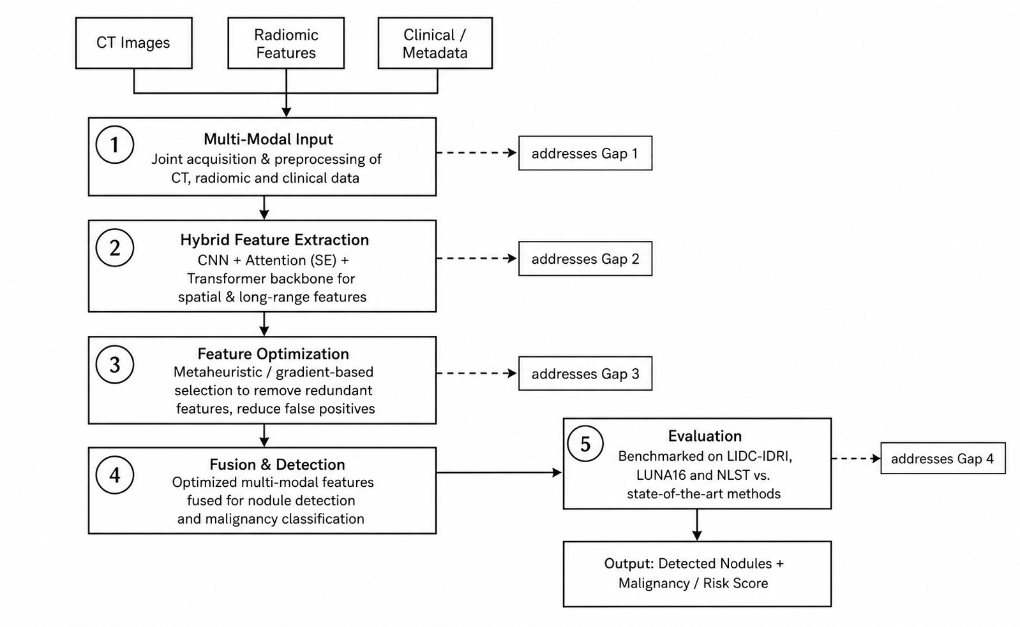
proposed methodology

Slide 13
datasets
LIDC-IDRI: 1,018 CT scans with radiologist annotations, malignancy ratings, and nodule characteristics.
LUNA16: A curated subset of LIDC-IDRI (888 scans) widely used as the standard nodule-detection benchmark.
NLST: National Lung Screening Trial data, providing large-scale CT scans with clinical outcome metadata.
Private/Multi-Hospital Cohorts: Used to test cross-institution generalization, as proposed in Objective 4.
Together, these datasets support benchmark comparison, multi-modal fusion, and robustness evaluation across scanners and populations.

Slide 14
FUTURE DIRECTION
“This work is planned to be published as a peer-reviewed paper reporting the complete framework and evaluation.”

Slide 15
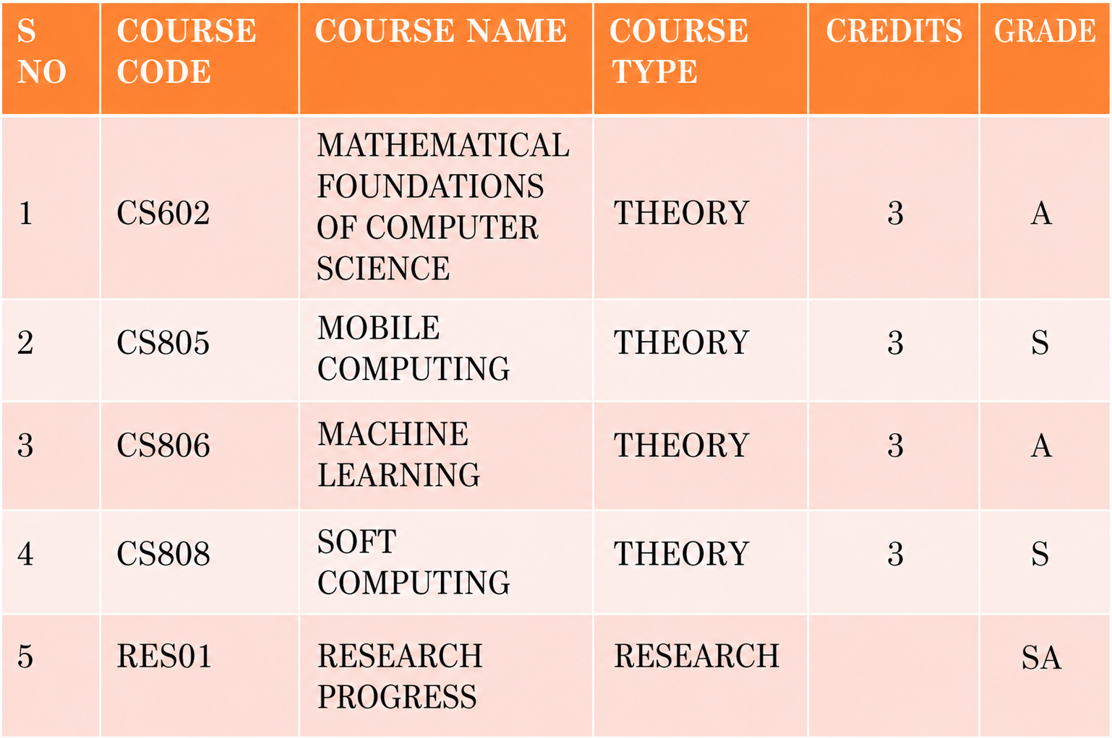
COURSE WORK
.

Slide 16
REFERENCES (1/3)
[1] C. Fan et al., "Clinical Prior Guided Cross-Modal Hierarchical Fusion for Histological Subtyping of Lung Cancer in CT Scans," Proc. Medical Image Computing and Computer-Assisted Intervention (MICCAI), Springer Nature Switzerland, 2025, pp. 75–84.
[2] A. Farooq et al., "Survival Prediction in Lung Cancer through Multi-Modal Representation Learning," Proc. IEEE/CVF Winter Conference on Applications of Computer Vision (WACV), IEEE, 2025, pp. 3907–3916.
[3] H. Su, H. Lei, G. Chen, and B. Lei, "Cross-Graph Interaction and Diffusion Probability Models for Lung Nodule Segmentation," Proc. Medical Image Computing and Computer-Assisted Intervention (MICCAI), Springer Nature Switzerland, 2024, pp. 482–492.
[4] M. Kiran Kumar and A. Amalanathan, "Advancements in Optimization Algorithms for Lung Nodule Detection and Classification: A Review," Proc. International Conference on Optimization Techniques for Learning (ICOTL), IEEE, 2023, pp. 229–234.
[5] T. Z. Li et al., "Longitudinal Multimodal Transformer Integrating Imaging and Latent Clinical Signatures from Routine EHRs for Pulmonary Nodule Classification," Proc. MICCAI 2023, Springer Nature Switzerland, 2023, pp. 649–659.
[6] Y. Lei, Z. Li, Y. Shen, J. Zhang, and H. Shan, "CLIP-Lung: Textual Knowledge-Guided Lung Nodule Malignancy Prediction," Proc. MICCAI 2023, Springer Nature Switzerland, 2023, pp. 403–412.
[7] J. Zhang et al., "Parse and Recall: Towards Accurate Lung Nodule Malignancy Prediction like Radiologists," Proc. MICCAI 2023, Springer Nature Switzerland, 2023, pp. 199–209.
[8] X. Luo et al., "SCPM-Net: An Anchor-Free 3D Lung Nodule Detection Network Using Sphere Representation and Center Points Matching," Medical Image Analysis, vol. 75, Art. no. 102287, 2022.
[9] Y. Li and Y. Fan, "DeepSEED: 3D Squeeze-and-Excitation Encoder-Decoder Convolutional Neural Networks for Pulmonary Nodule Detection," Proc. IEEE ISBI, IEEE, 2020, pp. 1866–1869.

Slide 17
REFERENCES (2/3)
[10] A. Sreekumar, K. R. Nair, S. Sudheer, H. G. Nayar, and J. J. Nair, "Malignant Lung Nodule Detection Using Deep Learning," Proc. IEEE International Conference on Communication and Signal Processing (ICCSP), IEEE, 2020, pp. 1368–1372.
[11] H. Tang, X. Liu, and X. Xie, "NoduleNet: Decoupled False Positive Reduction for Pulmonary Nodule Detection and Segmentation," Proc. MICCAI 2019, Springer Nature Switzerland, 2019, pp. 266–274.
[12] H. Tang, X. Liu, and X. Xie, "An End-to-End Framework for Integrated Pulmonary Nodule Detection and False Positive Reduction," Proc. IEEE International Symposium on Biomedical Imaging (ISBI), IEEE, 2019, pp. 859–862.
[13] W. Zhu, C. Liu, W. Fan, and X. Xie, "DeepLung: 3D Deep Convolutional Networks for Automated Pulmonary Nodule Detection and Classification," Proc. IEEE Winter Conference on Applications of Computer Vision (WACV), IEEE, 2018, pp. 673–681
[14] N. Khosravan and U. Bagci, "S4ND: Single-Shot Single-Scale Lung Nodule Detection," Proc. MICCAI 2018, Springer Nature Switzerland, 2018, pp. 794–802.
[15] W. Zhu, Y. S. Vang, Y. Huang, and X. Xie, "DeepEM: Deep 3D ConvNets with EM for Weakly Supervised Pulmonary Nodule Detection," Proc. MICCAI 2018, Springer Nature Switzerland, 2018, pp. 812–820
[16] H. Tang, D. R. Kim, and X. Xie, "Automated Pulmonary Nodule Detection Using 3D Deep Convolutional Neural Networks," Proc. IEEE International Symposium on Biomedical Imaging (ISBI), IEEE, 2018, pp. 523–526.
[17] B. Wu, Z. Zhou, J. Wang, and Y. Wang, "Joint Learning for Pulmonary Nodule Segmentation, Attributes and Malignancy Prediction," Proc. IEEE International Symposium on Biomedical Imaging (ISBI), IEEE, 2018, pp. 1109–1113.
[18] D. A. B. Oliveira and M. P. Viana, "An Efficient Multi-Scale Data Representation Method for Lung Nodule False Positive Reduction Using CNNs," Proc. IEEE International Symposium on Biomedical Imaging (ISBI), IEEE, 2018, pp. 235–242.

Slide 18
REFERENCES (3/3)
[19] R. V. M. Nóbrega, S. A. Peixoto, S. P. P. Silva, and P. P. R. Filho, "Lung Nodule Classification via Deep Transfer Learning in CT Lung Images," Proc. IEEE 31st International Symposium on Computer-Based Medical Systems (CBMS), IEEE, 2018, pp. 244–249.
[20] Y. Xie, Y. Xia, J. Zhang, D. Feng, M. Fulham, and W. Cai, "Transferable Multi-model Ensemble for Benign-Malignant Lung Nodule Classification on Chest CT," Proc. MICCAI 2017, Springer Nature Switzerland, 2017, pp. 656–664.
[21] J. Ding, A. Li, Z. Hu, and L. Wang, "Accurate Pulmonary Nodule Detection in Computed Tomography Images Using Deep Convolutional Neural Networks," Proc. MICCAI 2017, Springer, LNCS vol. 10435, 2017, pp. 559–567
[22] S. Hussein, H. Cao, Q. Song, and U. Bagci, "Risk Stratification of Lung Nodules Using 3D CNN-Based Multi-Task Learning," Proc. IPMI 2017, Springer, LNCS vol. 10265, 2017, pp. 249–260.
[23] H. Huang, J. Shan, and V. Vaidya, "Lung Nodule Detection in CT Using 3D Convolutional Neural Networks," Proc. IEEE 14th International Symposium on Biomedical Imaging (ISBI 2017), IEEE, 2017, pp. 379–383.
[24] S. Hussein, R. Gillies, K. Cao, Q. Song, and U. Bagci, "TumorNet: Lung Nodule Characterization Using Multi-View Convolutional Neural Network with Gaussian Process," Proc. IEEE 14th International Symposium on Biomedical Imaging (ISBI 2017), IEEE, 2017, pp. 1007–1010.
[25] R. Golan, C. Jacob, and J. Denzinger, "Lung Nodule Detection in CT Images Using Deep Convolutional Neural Networks," Proc. IEEE International Joint Conference on Neural Networks (IJCNN 2016), IEEE, 2016, pp. 243–250
[26] S. Parveen and C. Kavitha, "Segmentation of CT Lung Nodules Using FCM with Firefly Search Algorithm," Proc. IEEE International Conference on Innovations in Information, Embedded and Communication Systems (ICIIECS), IEEE, 2015, pp. 1–5

Slide 19
Thank You

